Slide 1

Two-Day Dyadic data analysis Workshop
Randi L. Garcia
Smith College
UCSF January 9th and 10th
 @RandiLGarcia  RandiLGarcia

Slide 2
Day 2
Mediation in the APIM
Moderation in the APIM
Dyadic Growth Curve Modeling
Other Longitudinal Models for Dyads

Slide 3
Mediation

Slide 4
Mediation
c
X
Y

Slide 5
Mediation
M
a
b
c'
X
Y

Slide 6
The Four Paths
X → Y: path c
X → M: path a
M → Y (controlling for X): path b
X → Y (controlling for M): path c′

Slide 7
Decomposition of Effects
Total Effect = Direct Effect + Indirect Effect
c = c′ + ab
Note that
ab = c - c′
Percent of the total effect mediated:
ab/c *100
or
(1 - c′/c ) *100

Slide 8
Strategies to Test null hypothesis: ab = 0
Sobel test
Bootstrapping
Monte Carlo Method

Slide 9
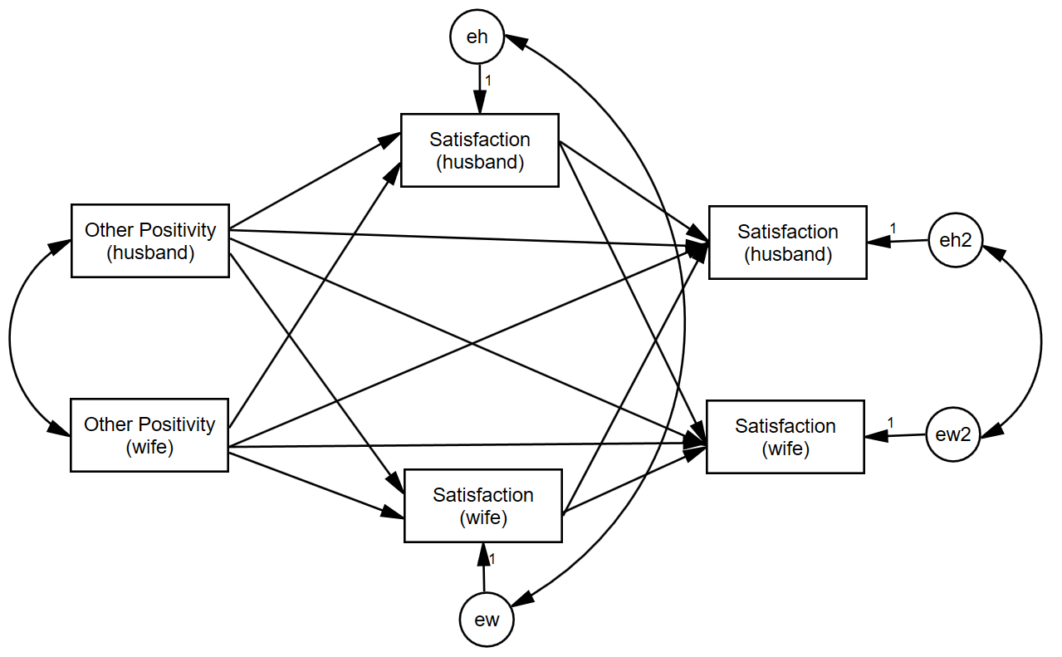
Example-Tension, Distinguishable

Slide 10
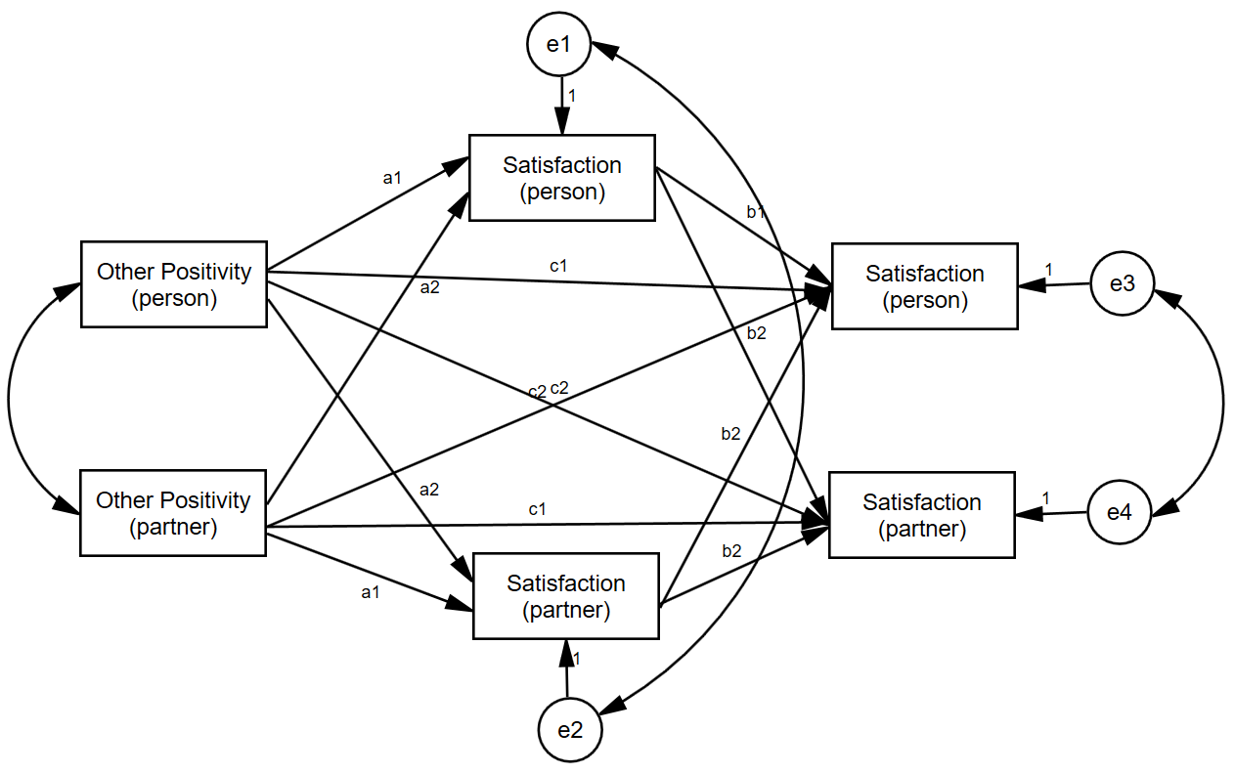
Example-Tension, Indistinguishable

Slide 11
R Demo

Slide 12
Moderation

Slide 13
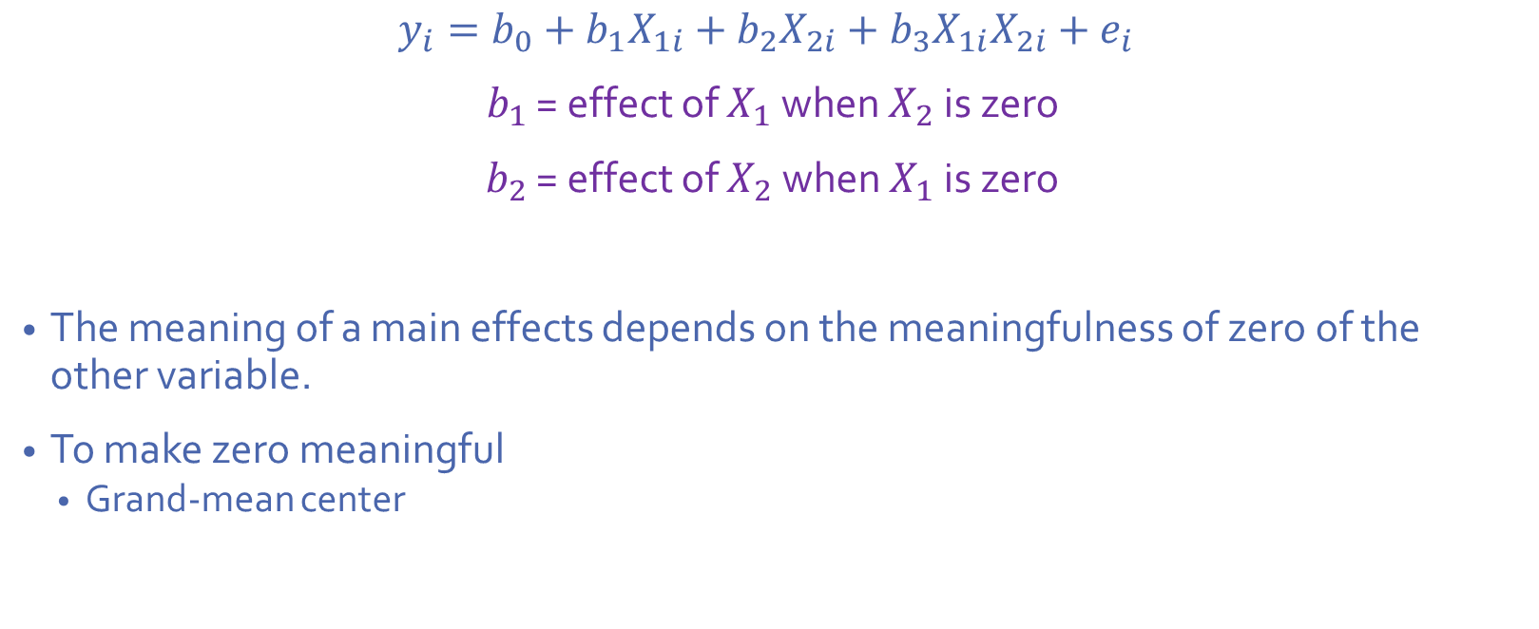
Centering Review
$$y_{i}=b_{0}+b_{1}X_{1i}+b_{2}X_{2i}+b_{3}X_{1i}X_{2i}+e_{i}$$
$b_{1}$ = effect of $X_{1}$ when $X_{2}$ is zero
$b_{2}$ = effect of $X_{2}$ when $X_{1}$ is zero
The meaning of a main effects depends on the meaningfulness of zero of the other variable.
To make zero meaningful
Grand-mean center

Slide 14
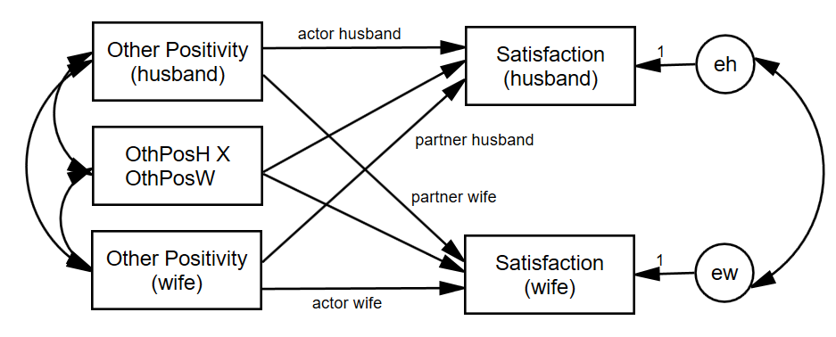
Actor-Partner Interactions
We can ask, does the actor effect get stronger or weaker as the partner variable goes up?

Slide 15
Dichotomous Within-Dyads Moderator
The distinguishing variable is a moderator.
The two partners each have a score but across dyads the average scores are the same (e.g., gender in heterosexual couples)
If dyad members are distinguishable, two moderation effects
Moderates the actor effect
Moderates the partner effect

Slide 16
Between-Dyads Moderator
One moderation variable (one score per dyad)
Examples
Years married
Couple level treatment
Gay vs. lesbian couples
Twins: separated at birth vs. raised together

Slide 17
Between-Dyads Moderator
Indistinguishable: Two moderation effects
Moderates the actor effect
Moderates the partner effect
Distinguishable: Four moderation effects
Moderates the actor effect for each member
Moderates the partner effect for each member

Slide 18
Mixed Moderator
The two partners each have a score, and the average score varies across dyads. Thus, there are really two moderator variables (actor and partner).
Indistinguishable: Four moderation effects
actor effect moderated by each member’s closeness
partner effect moderated by each member’s closeness
Distinguishable: Eight moderation effects
Each of the above also moderated by member type (e.g., husband and wife)
It would be great if we could simplify, find patterns among, these effects.

Slide 19
R Demo

Slide 20
Longitudinal Models

Slide 21
Examples of Over-Time Dyadic Data
Daily diary reports of relationship experiences from both members of heterosexual dating partners over 14 days
Repeated measures experiment where dyads interact with each other multiple times and make ratings after each interaction
Daily reports of closeness from both members of college roommate dyads

Slide 22
Basic Data Structure
The three-level nested myth: Time is nested within person and person is nested within dyad
Three-level nested only if the four time points differ such that T1a ≠ T1b, T2a ≠ T2b, etc.

Slide 23
Basic Data Structure
Dyad 1
In most cases the two dyad members are measured at the same time points, so Time is crossed with person.
Husband
Wife
T1
H_T1
W_T1
T2
H_T2
W_T2
T3
H_T3
W_T3
T4
H_T4
W_T4

Slide 24
Basic Data Structure
This two-level crossed structure results in an error structure in which the residuals may be correlated both
across dyad members
across time
H - Time 1
H - Time 2
H - Time 3
H - Time 4
Satisfaction
Satisfaction
Satisfaction
Satisfaction
eM1
eM2
eM3
em4
eF1
eF2
eF3
eF4
W - Time 1
W - Time 2
W - Time 3
W - Time 4
Satisfaction
Satisfaction
Satisfaction
Satisfaction

Slide 25
Types of Over-Time Models
Repeated Measures Model
Interest only in the effects of “time” across persons and dyads.
Growth Curve Model
Are there linear changes over time in the outcome variable?
Stability and Influence Model
Stability: Does Person A’s score at time 1 predict Person A’s score at time 2?
Influence: Does Person A’s score at time 1 predict Person B’s score at time 2?
Standard APIM
Different variables as the predictors and at the outcome
Does Variable 1 predict Variable 2?

Slide 26
Examples
Repeated Measures
The effect of day of the week (weekday versus weekend) and gender
Growth Curve Model
Individual growth curve
Dyadic growth curve
Satisfaction over time
Stability and Influence Model
Prior satisfaction predicts current satisfaction
Standard APIM
Actor and partner conflict predict satisfaction
Notes:
EDIT

Slide 27
Types of Variables
Time Invariant
Do not change over time
Measured at one time point only (typically the beginning of the study)
E.g., gender, attachment style, race
Time Varying
Measured at each time
E.g., daily mood, twice-weekly reports of friendship
Outcome variable must be time varying

Slide 28
How Many Time Points?
Depends on type of analysis
The more complicated the model, the more time points needed
Minimum
Repeated measures: Two
Other models: Three
More is better.
Ultimately depends on the model, the research setting, and research questions.

Slide 29
Example: Daily reports of conflict, support, and relationship satisfaction
Kashy data set
103 heterosexual dating couples
Assessed once daily for 14 days
Completed daily reports of relationship satisfaction and amount of conflict that day
Satisfaction and Conflict are time-varying
Pretest data for attachment avoidance
Measured for both people
Time invariant
Notes:
Only going to talk about satisfaction and attachment avoidance data
-back to kashy data

Slide 30
Person Period Pairwise Dataset
Each Person by Time combination has its own record
Person has its own variable (e.g., Person = 1, 2)
Occasion has its own variable (e.g., Day = 1 to 14)
Required for Multilevel Modeling
We’ll look at it when we get to R

Slide 31
Modeling Two Growth Curves
Y_{Wti} = c_{Wi} + b_{Wi}T_{ti} + e_{Wti}
Y_{Mti} = c_{Mi} + b_{Mi}T_{ti} + e_{Mti}
Intercepts
c_{Wi} = Predicted value of women’s satisfaction at study midpoint for dyad i
c_{Mi} = Predicted value of men’s satisfaction at study midpoint for dyad i
Slopes
b_{Wi} = Average change in women’s satisfaction over time for dyad i
b_{Mi} = Average change in men’s satisfaction over time for dyad I
Errors at each time point
Women = e_{Wti}
Men = e_{Mti}

Slide 32
Correlation of the Residuals
If the man reports more satisfaction for a particular day than would be expected given the overall effect of time, does the woman also report more satisfaction for that day?

Slide 33
Random Effects: Variances
There are six variances
two intercepts
Do men (and women) differ from each other in their “time zero” predicted score?
two slopes for time
Do the slopes for men (and women) differ?
two error (distance from the line) variances
Error variances (deviations from the slope) for men and women

Slide 34
Random Effects: Within Person Correlations
Man intercept-slope correlation
If a man is highly satisfied at the study midpoint, is his change in satisfaction steeper?
Woman intercept-slope correlation
If a woman is highly satisfied at the study midpoint, is her change in satisfaction steeper?
34
Notes:
34
Make these faint (they need to be in here but we aren’t going to talk about them)

Slide 35
Four Between-Person Correlations
Correlation of the intercepts between partners
Overall, do women who have higher levels of satisfaction at the study midpoint tend to have male partners who are also higher in satisfaction at the study midpoint?
That is: Is there a correspondence between level of satisfaction?
Correlation of the slopes
Do women whose satisfaction changes over time tend to have male partners whose satisfaction also changes over time?
That is: Is there a correspondence between linear change in satisfaction?
Two slope-intercept correlations
Do women with higher levels of satisfaction have male partners who increase or decrease?
Do men with higher levels of satisfaction have female partners who increase or decrease
Notes:
Do we want to keep all of this?
-lighten these up. Emphasize the first two (less the third)

Slide 36
Estimates of Random Effects
 |  | Man Intercept | Woman Intercept | Man Time Slope | Woman Time Slope
Man Intercept | sd
Woman Intercept | sd | r
Man Slope | sd | r | r
Woman Slope | sd | r | r | r
Residual | sd
Rho
The random option specifies the variances (given as standard deviations) and covariances (given as correlations) between the intercepts and slopes

Slide 37
Why Random Effects Are Important
If the wrong random model is selected (one that is too complicated), the solution may not converge.
If the wrong model is selected (one that is too simple), significance tests of fixed are wrong.
Standard errors are biased
They are interesting in their own right.
Answers interesting questions about individual differences and similarity of dyad members.
Points to possible moderators.
Can be combined with fixed effects for interpretation.

Slide 38
R Demo

Slide 39
Longitudinal APIM

Slide 40
Longitudinal APIM
This is old hat—but the random actor and partner effects are the most interesting!
Man’s Actor
Man’s Conflict
Man’s Satisfaction
W to M Partner
M to W Partner
Woman’s Conflict
Woman’s Satisfaction
Woman’s Actor

Slide 41
Data Structure
ID | Dyad | Partnum | Time | Actor Satis. | Actor Conflict | Partner Conflict
25 | 13 | 1 | 1 | 2 | 5 | 5
25 | 13 | 1 | 2 | 5 | 2 | 3
25 | 13 | 1 | 3 | 7 | 5 | 6
25 | 13 | 1 | 4 | 4 | 7 | 8
26 | 13 | 2 | 1 | 3 | 5 | 5
26 | 13 | 2 | 2 | 6 | 3 | 2
26 | 13 | 2 | 3 | 8 | 6 | 5
26 | 13 | 2 | 4 | 2 | 8 | 7

Slide 42
Stability and Influence
Notes:
AKA responsiveness (as to make it not so partner focused)

Slide 43
Stability-Influence: APIM
Man’s Satisfaction Yesterday
Man stability
Man’s Satisfaction Today
Woman influence
Man influence
Woman’s Satisfaction Yesterday
Woman’s Satisfaction Today
Woman stability
We can measure stability and influence for each man and each woman:
Is stability moderated by gender?
Is influence moderated by gender?

Slide 44
Data Structure
ID | DYADID | PERSON | DAY | ASATISF | ASATISF Lagged | PSATISF Lagged
25 | 13 | 1 | 1 | 2 | . | .
25 | 13 | 1 | 2 | 5 | 2 | 3
25 | 13 | 1 | 3 | 7 | 5 | 6
25 | 13 | 1 | 4 | 4 | 7 | 8
26 | 13 | 2 | 1 | 3 | . | .
26 | 13 | 2 | 2 | 6 | 3 | 2
26 | 13 | 2 | 3 | 8 | 6 | 5
26 | 13 | 2 | 4 | 2 | 8 | 7

Slide 45
R Demo

Slide 46
Common Fate Model

Slide 47
Dyadic Models
The Common Fate Model (CFM) is perhaps the oldest dyadic model (Kenny & La Voie, 1985).
However, CFM used empirically only a handful of times.
The APIM which is regularly used (at least 95% of the time) may often be theoretically inappropriate.
Paper: Ledermann, T., & Kenny, D. A. (2012). The common fate model for dyadic data: Variations of a theoretically important but underutilized model. Journal of Family Psychology, 26, 140‑148.
Notes:
47

Slide 48
The CFM as a SEM Model
The Common Fate Model (CFM) consists of 2 latent variables (X and Y) and 2 indicators (X_{A} and X_{B}, Y_{A} and Y_{B}) where A and B are distinguishable members of a dyad.
e₁
e₂
e₃
e₄
1
1
1
1
X_{A}
X_{B}
Y_{A}
Y_{B}
a
a
1
1
1
1
X
b
Y
1
r_{Y}
The model has 1 df.
That 1 df can be viewed as testing if the loading on X_{B} and Y_{B} are not equal to one. If fit is poor, the two loadings can be fixed to the same value.

Slide 49
Indistinguishable Members
Five equality constraints are made: equal X and Y intercepts, equal X and Y error variances, and equal error covariances.
e₁
e₂
e₃
e₄
1
1
1
1
X_{A}
X_{B}
Y_{A}
Y_{B}
1
1
1
1
X
b
Y
1
r_{Y}
With these constraints, the model has zero df.
Notes:
49

Slide 50
When Does the CFM Make Sense?
The latent variable represents a dyadic construct (“us,” “we,” or “the relationship” instead of “you” or “him or her”) or shared external influences.
The causal relation between the variables is presumed to be at the level of the dyad.

Slide 51
When Does the CFM Not Make Sense?
The variable measures an individual characteristic: how the individual feels or the individual’s personality.
The two dyad members scores correlate weakly with each other. If the correlation between the two X or Y scores is weak (r < .30), there can be estimation difficulties.

Slide 52
Advantages of the CFM over the APIM
Has a true “dyad-level” effect, not individual-level effects
Parsimony: For moderation and mediation in the APIM, there can be up to 8 effects. For the CFM, there is just one. Thus, the CFM is simpler.
Notes:
52

Slide 53
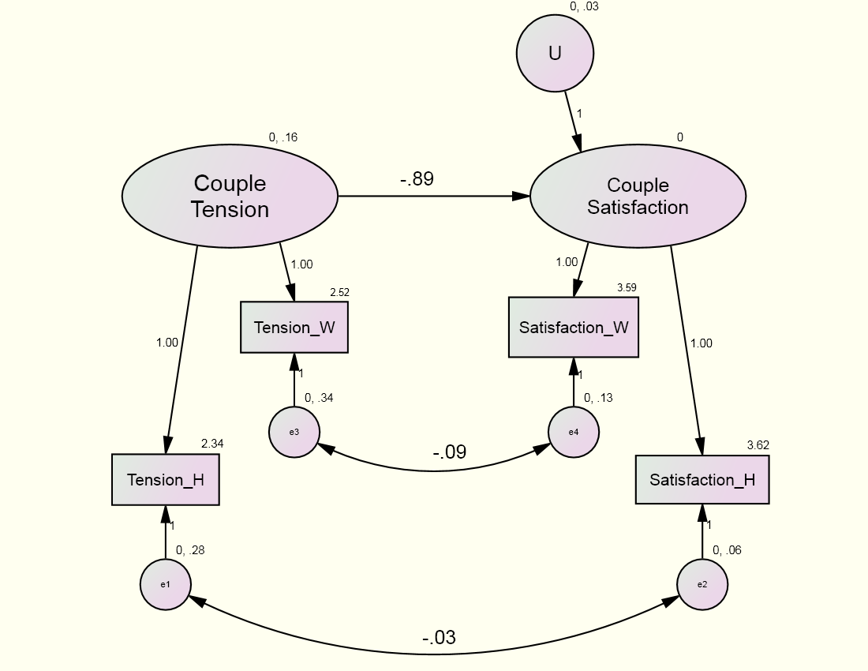
Example: Standard CFM
χ²(1) = 0.179, p = .672

Slide 54
R DEMO

Slide 55
(Current/Known) Limits of R
Indistinguishable dyads
Needs to be analyzed in SAS, HLM, or MLwiN because constraints on the variance-covariance matrix or random effects are needed.
P-values for random effects

Slide 56
Topics Not Covered
Indistinguishable dyads
Time-varying moderators
E.g., daily mood moderates daily satisfaction
Non-linear growth curve models
Transformations
Periodic effects
Cubic, quadratic
More complicated error models
Longitudinal models with non-normal outcomes—but glmer() can handle them

Slide 57
Bonus: Common fate growth model

Slide 58
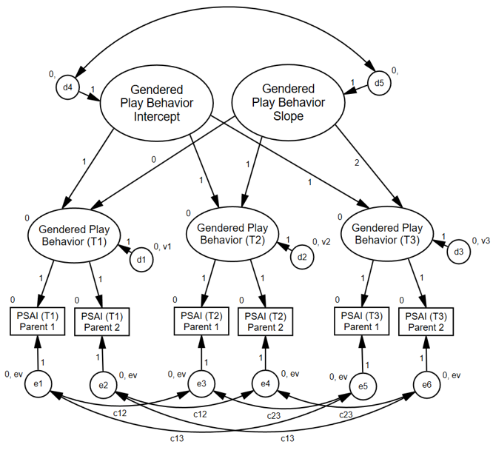
Children’s Gendered Behavior Overtime
Goldberg & Garcia (2016)

Slide 59
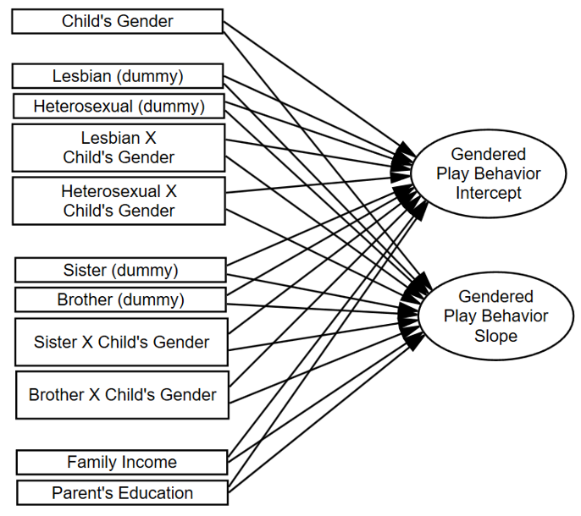
Children’s Gendered Behavior Overtime

Slide 60
Bonus: Other SEM dyad models

Slide 61
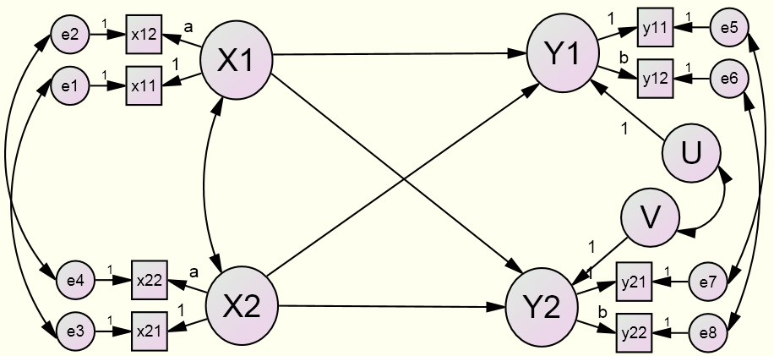
Latent Variable APIM
Advantages over Traditional APIM
Effects may be larger.
Effects are less biased.

Slide 62
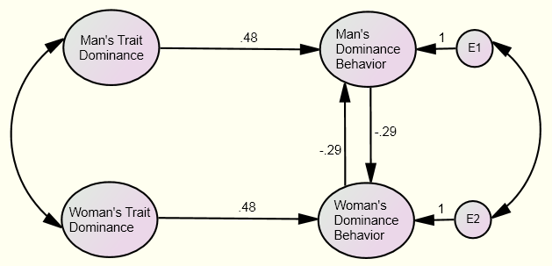
The Mutual Influence Model

